Slide 1
Topic 5
Understanding Performance
(modified by J. Nelson Amaral)
Notes:
Morgan Kaufmann Publishers
Chapter 1 — Computer Abstractions and Technology

Slide 2
Understanding Performance
Algorithm
  Determines number of operations executed
Programming language, compiler, architecture
  Determine number of machine instructions executed per operation
Processor and memory system
  Determine how fast instructions are executed
I/O system (including OS)
  Determines how fast I/O operations are executed
Chapter 1 — Computer Abstractions and Technology — <number>
P-H p. 9
Notes:
Morgan Kaufmann Publishers
Chapter 1 — Computer Abstractions and Technology

Slide 3


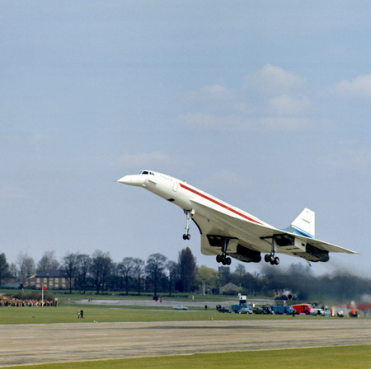

Defining Performance
§1.4 Performance
Which airplane has the best performance?
Boeing 777
Boeing 747
Bac/Sud Concorde
Douglas DC-8-50
Chapter 1 — Computer Abstractions and Technology — <number>
Notes:
Morgan Kaufmann Publishers
Chapter 1 — Computer Abstractions and Technology

Slide 4




Defining Performance
§1.4 Performance
Which airplane has the best performance?
Chapter 1 — Computer Abstractions and Technology — <number>
P-H p. 28
Notes:
Morgan Kaufmann Publishers
Chapter 1 — Computer Abstractions and Technology

Slide 5
Response Time and Throughput
Response time
  How long it takes to do a task
Throughput
  Total work done per unit of time
    e.g., tasks/transactions/… per hour
Chapter 1 — Computer Abstractions and Technology — <number>
P-H p. 28
Notes:
Morgan Kaufmann Publishers
Chapter 1 — Computer Abstractions and Technology

Slide 6
Latency (Response Time) × Throughput
What matters is latency:
Start
Time
What matters is throughput:
Start
Time

Slide 7
Response Time and Throughput
How are response time and throughput affected by
  Replacing the processor with a faster version?
  Adding more processors?
We’ll focus on response time for now…
Chapter 1 — Computer Abstractions and Technology — <number>
P-H p. 28
Notes:
Morgan Kaufmann Publishers
Chapter 1 — Computer Abstractions and Technology

Slide 8
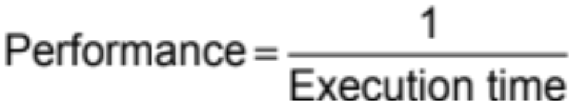
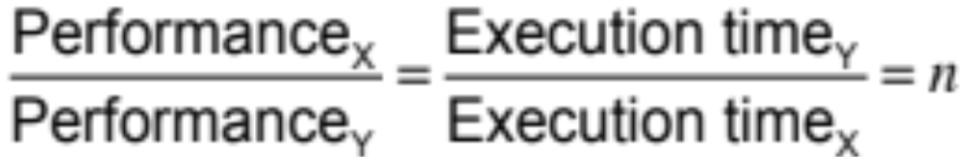
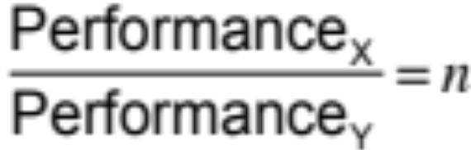
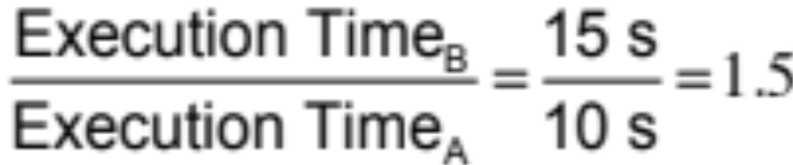
Relative Performance
What “X is n times faster than Y” means?
Example: time taken to run a program
  10 s on machine A, 15 s on machine B
  Thus, A is 1.5 times faster than B
Chapter 1 — Computer Abstractions and Technology — <number>
P-H p. 29
Notes:
Morgan Kaufmann Publishers
Chapter 1 — Computer Abstractions and Technology

Slide 9
Measuring Execution Time
Elapsed time
  Total response time, including all aspects
    Processing, I/O, OS overhead, idle time
  Determines system performance
CPU time
  Time spent processing a given job
    Discounts I/O time, other jobs’ shares
  Comprises user CPU time and system CPU time
  Different programs are affected differently by CPU and system performance
Chapter 1 — Computer Abstractions and Technology — <number>
P-H p. 30
Notes:
Morgan Kaufmann Publishers
Chapter 1 — Computer Abstractions and Technology

Slide 10
CPU Clocking
Operation of digital hardware is governed by a constant-rate clock
Clock period
Clock (cycles)
Data transfer
and computation
Update state
Clock period: duration of a clock cycle
  e.g., 250 ps = 0.25 ns = 250×10^{–12} s
Clock frequency (rate): cycles per second
  e.g., 4.0 GHz = 4000 MHz = 4.0×10⁹ Hz
Chapter 1 — Computer Abstractions and Technology — <number>
P-H p. 31
Notes:
Morgan Kaufmann Publishers
Chapter 1 — Computer Abstractions and Technology

Slide 11
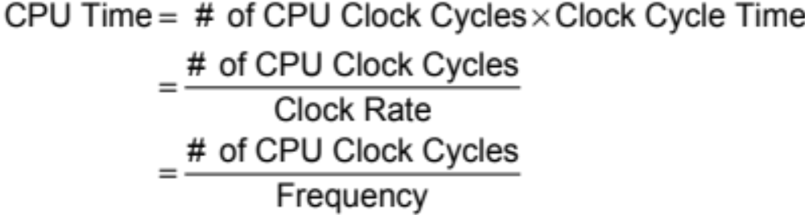
CPU Time
Performance improved by
  Reducing number of clock cycles
  Increasing clock rate
Hardware designer must often trade off clock rate against cycle count
Chapter 1 — Computer Abstractions and Technology — <number>
P-H p. 32
Notes:
Morgan Kaufmann Publishers
Chapter 1 — Computer Abstractions and Technology

Slide 12
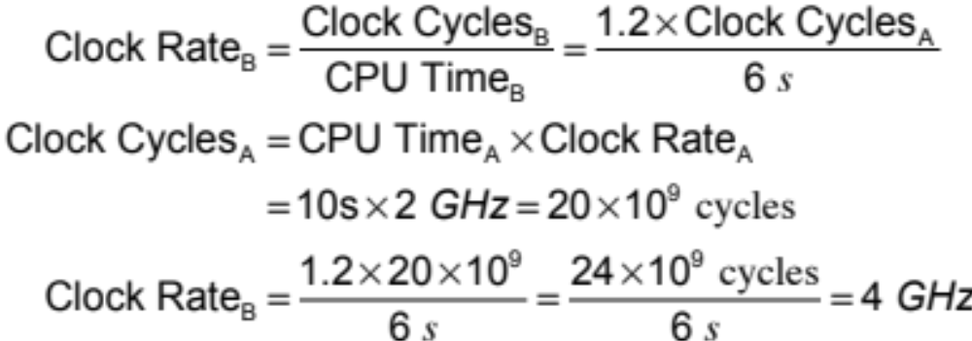
CPU Time Example
Computer A: 2 GHz clock, 10 s CPU time
Designing Computer B
  Aim for 6 s CPU time
  Can do faster clock, but causes 1.2 × clock cycles
How fast must Computer B clock be?
Chapter 1 — Computer Abstractions and Technology — <number>
P-H p. 33
Notes:
Morgan Kaufmann Publishers
Chapter 1 — Computer Abstractions and Technology

Slide 13
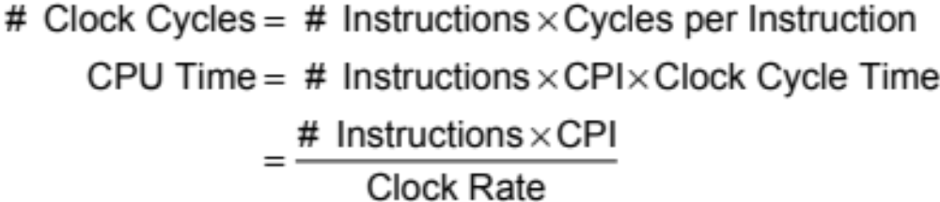
Instruction Count and CPI
Instruction Count for a program
  Determined by program, ISA and compiler
Average cycles per instruction (CPI)
  Determined by CPU hardware
  If different instructions have different CPI
    Average CPI affected by instruction mix
Chapter 1 — Computer Abstractions and Technology — <number>
P-H p. 35
Notes:
Morgan Kaufmann Publishers
Chapter 1 — Computer Abstractions and Technology

Slide 14
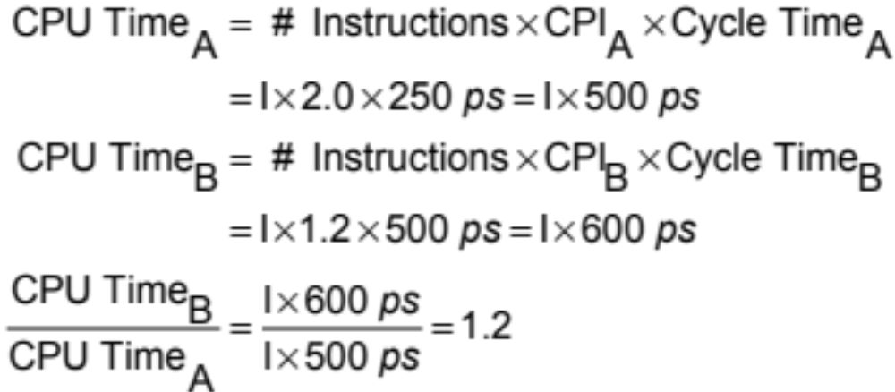
CPI Example
Computer A: Cycle Time = 250 ps, CPI = 2.0
Computer B: Cycle Time = 500 ps, CPI = 1.2
Same ISA, same program and same compiler
Which one is faster, and by how much?
A is faster…
…by this much
Chapter 1 — Computer Abstractions and Technology — <number>
P-H p. 35
Notes:
Morgan Kaufmann Publishers
Chapter 1 — Computer Abstractions and Technology

Slide 15
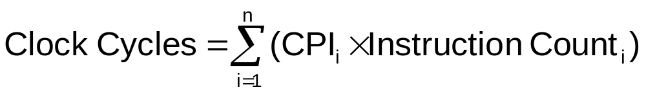

CPI in More Detail
If different instruction classes take different numbers of cycles
CPI is a weighted average:
Relative frequency
Chapter 1 — Computer Abstractions and Technology — <number>
P-H p. 36
Notes:
Morgan Kaufmann Publishers
Chapter 1 — Computer Abstractions and Technology

Slide 16
CPI Example
Alternative compiled code sequences using instructions in classes A, B, C. What is the CPI for each sequence?
Class | A | B | C
CPI for class | 1 | 2 | 3
IC in sequence 1 | 2 | 1 | 2
IC in sequence 2 | 4 | 1 | 1
Sequence 1: IC = 5
  Clock Cycles
  = 2×1 + 1×2 + 2×3
  = 10
  Avg. CPI = 10/5 = 2.0
Sequence 2: IC = 6
  Clock Cycles
  = 4×1 + 1×2 + 1×3
  = 9
  Avg. CPI = 9/6 = 1.5
Chapter 1 — Computer Abstractions and Technology — <number>
P-H p. 36
Notes:
Morgan Kaufmann Publishers
Chapter 1 — Computer Abstractions and Technology

Slide 17

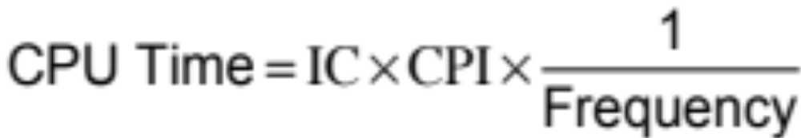
Performance Summary
The BIG Picture
Performance depends on
  Algorithm: affects IC, possibly CPI
  Programming language: affects IC, CPI
  Compiler: affects IC, CPI
  Instruction set architecture: affects IC, CPI, frequency
Chapter 1 — Computer Abstractions and Technology — <number>
P-H p. 35
Notes:
Morgan Kaufmann Publishers
Chapter 1 — Computer Abstractions and Technology

Slide 18
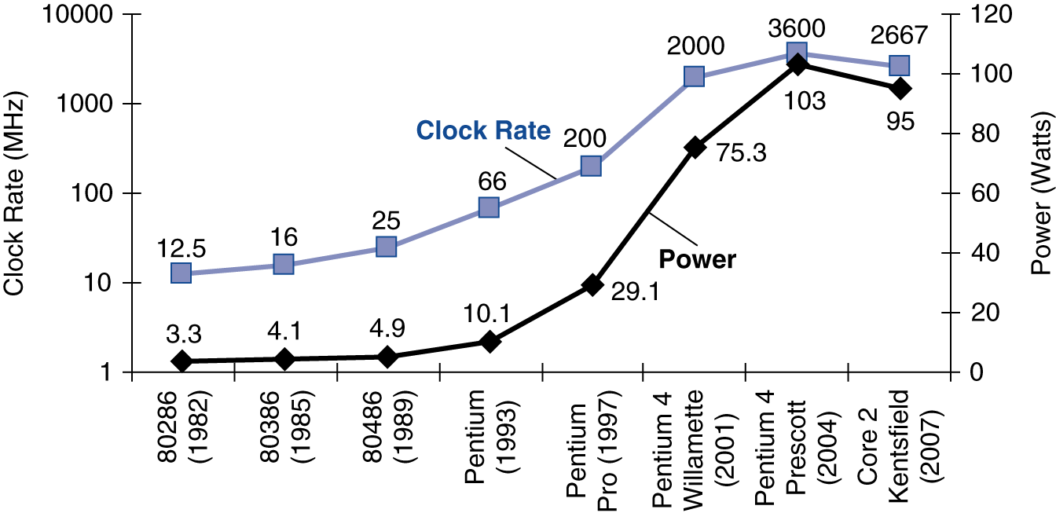
Power Trends
§1.5 The Power Wall
In CMOS IC technology
×30
5V → 1V
×1000
Chapter 1 — Computer Abstractions and Technology — <number>
P-H p. 39
Notes:
Morgan Kaufmann Publishers
Chapter 1 — Computer Abstractions and Technology

Slide 19
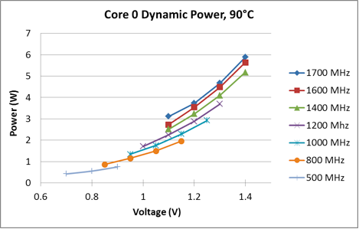
Power X Frequency X Voltage
Source: http://chipdesignmag.com/lpd/pangrle/tag/amd/
Chapter 1 — Computer Abstractions and Technology — <number>

Slide 20
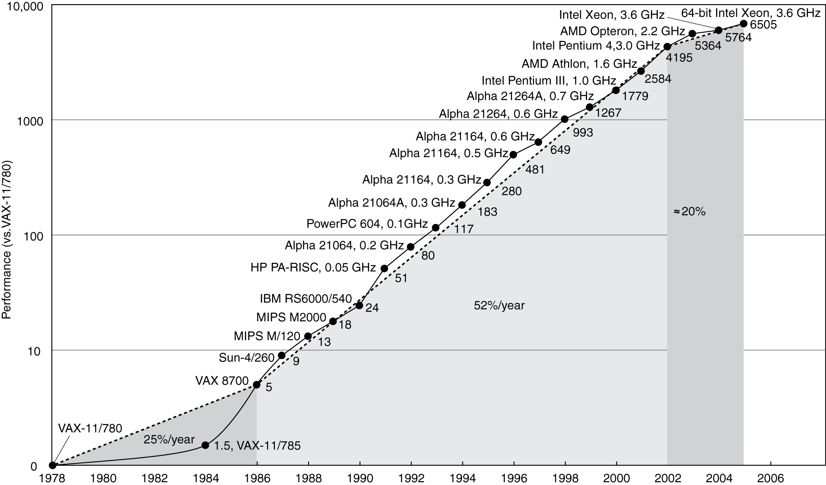
Uniprocessor Performance
§1.6 The Sea Change: The Switch to Multiprocessors
Constrained by power, instruction-level parallelism, memory latency
Chapter 1 — Computer Abstractions and Technology — <number>
P-H p. 42
Notes:
Morgan Kaufmann Publishers
Chapter 1 — Computer Abstractions and Technology

Slide 21
Multiprocessors
Multicore microprocessors
  More than one processor per chip
Requires explicitly parallel programming
  Compare with instruction level parallelism
    Hardware executes multiple instructions at once
    Hidden from the programmer
  Hard to do
    Programming for performance
    Load balancing
    Optimizing communication and synchronization
Chapter 1 — Computer Abstractions and Technology — <number>
P-H p. 41
Notes:
Morgan Kaufmann Publishers
Chapter 1 — Computer Abstractions and Technology

Slide 22

SPEC CPU Benchmark
Programs used to measure performance
  Supposedly typical of actual workload
Standard Performance Evaluation Corp (SPEC)
  Develops benchmarks for CPU, I/O, Web, …
SPEC CPU2006
  Elapsed time to execute a selection of programs
    Negligible I/O, so focuses on CPU performance
  Normalize relative to reference machine
  Summarize as geometric mean of performance ratios
    CINT2006 (integer) and CFP2006 (floating-point)
Chapter 1 — Computer Abstractions and Technology — <number>
P-H p. 49
Notes:
Morgan Kaufmann Publishers
Chapter 1 — Computer Abstractions and Technology

Slide 23
CINT2006 for Opteron X4 2356
Name | Description | IC×10⁹ | CPI | Tc (ns) | Exec time | Ref time | SPECratio
perl | Interpreted string processing | 2,118 | 0.75 | 0.40 | 637 | 9,777 | 15.3
bzip2 | Block-sorting compression | 2,389 | 0.85 | 0.40 | 817 | 9,650 | 11.8
gcc | GNU C Compiler | 1,050 | 1.72 | 0.40 | 824 | 8,050 | 11.1
mcf | Combinatorial optimization | 336 | 10.00 | 0.40 | 1,345 | 9,120 | 6.8
go | Go game (AI) | 1,658 | 1.09 | 0.40 | 721 | 10,490 | 14.6
hmmer | Search gene sequence | 2,783 | 0.80 | 0.40 | 890 | 9,330 | 10.5
sjeng | Chess game (AI) | 2,176 | 0.96 | 0.40 | 837 | 12,100 | 14.5
libquantum | Quantum computer simulation | 1,623 | 1.61 | 0.40 | 1,047 | 20,720 | 19.8
h264avc | Video compression | 3,102 | 0.80 | 0.40 | 993 | 22,130 | 22.3
omnetpp | Discrete event simulation | 587 | 2.94 | 0.40 | 690 | 6,250 | 9.1
astar | Games/path finding | 1,082 | 1.79 | 0.40 | 773 | 7,020 | 9.1
xalancbmk | XML parsing | 1,058 | 2.70 | 0.40 | 1,143 | 6,900 | 6.0
Geometric mean |  |  |  |  |  |  | 11.7
High cache miss rates
Chapter 1 — Computer Abstractions and Technology — <number>
P-H p. 49
Notes:
Morgan Kaufmann Publishers
Chapter 1 — Computer Abstractions and Technology

Slide 24


Pitfall: Amdahl’s Law
Improving an aspect of a computer and expecting a proportional improvement in overall performance
§1.8 Fallacies and Pitfalls
Example: multiply accounts for 80s/100s
  How much improvement in multiply performance to get 5× overall?
  Can’t be done!
Corollary: make the common case fast
Chapter 1 — Computer Abstractions and Technology — <number>
P-H p. 51
Notes:
Morgan Kaufmann Publishers
Chapter 1 — Computer Abstractions and Technology

Slide 25
Fallacy: Low Power at Idle
SPEC Power X4 benchmark
  At 100% load: 295W
  At 50% load: 246W (83%)
  At 10% load: 180W (61%)
Google data center
  Mostly operates at 10% – 50% load
  At 100% load less than 1% of the time
Consider designing processors to make power proportional to load
Chapter 1 — Computer Abstractions and Technology — <number>
P-H p. 52
Notes:
Morgan Kaufmann Publishers
Chapter 1 — Computer Abstractions and Technology

Slide 26

Pitfall: MIPS as a Performance Metric
MIPS: Millions of Instructions Per Second
  Doesn’t account for
    Differences in ISAs between computers
    Differences in complexity between instructions
  CPI varies between programs on a given CPU
Chapter 1 — Computer Abstractions and Technology — <number>
P-H p. 53
Notes:
Morgan Kaufmann Publishers
Chapter 1 — Computer Abstractions and Technology

Slide 27
Concluding Remarks
Cost/performance is improving
  Due to underlying technology development
Hierarchical layers of abstraction
  In both hardware and software
Instruction-set architecture
  The hardware/software interface
Execution time: the best performance measure
Power is a limiting factor
  Use parallelism to improve performance
§1.9 Concluding Remarks
Chapter 1 — Computer Abstractions and Technology — <number>
P-H p. 54
Notes:
Morgan Kaufmann Publishers
Chapter 1 — Computer Abstractions and Technology

Slide 28
Image Sources
Besides the images copyrighted to Morgan Kaufman, this set of slides
include images extracted from the following websites:
http://blog.navx.com/photos/uncategorized/2007/12/18/gps_tomtom_iphon.jpg
http://www.asbavionics.com/ASB%20Avionics%20New%20Release%20Photo%206-6-07_small.jpg
http://www.kikm.org/images/Human%20Genome%20Project.jpg
http://www.simviation.com/hjg/aircraft/douglas/dc-8-50/dc-8-50_aeronaves_de_mexico_1963_51_xa-nus.jpg
http://www.skycontrol.net/UserFiles/Image/BusinessGA_img/200703/200703boeing-777-200LR-worldliner.jpg
http://www.searchengineoptimizationcompany.ca/img/Search-Engine-Marketing.jpg
http://www.aerospaceweb.org/aircraft/jetliner/b747/b747_02.jpg
http://images.digitalmedianet.com/2007/Week_35/t63buhsr/story/iphone.jpg
http://cache.gizmodo.com/assets/resources/2007/06/iphone7%20copy.jpg
http://www.flightglobal.com/blogs/flight-international/assets_c/2009/04/Concorde%20landing%20at%20Fairford-thumb-450x448.jpg
http://www.ibiblio.org/hhalpin/homepage/presentations/de2007/webearth.jpg
http://gigatekperu.com/pictures/big/1.jpg
Chapter 1 — Computer Abstractions and Technology — <number>

